Slide 1
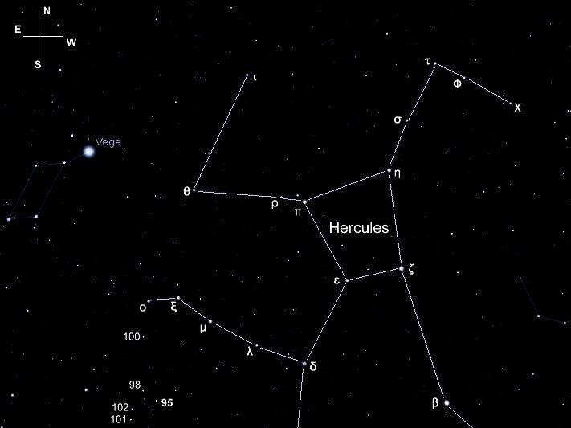
Other Names:
95 Herculis
95 Her

Slide 2
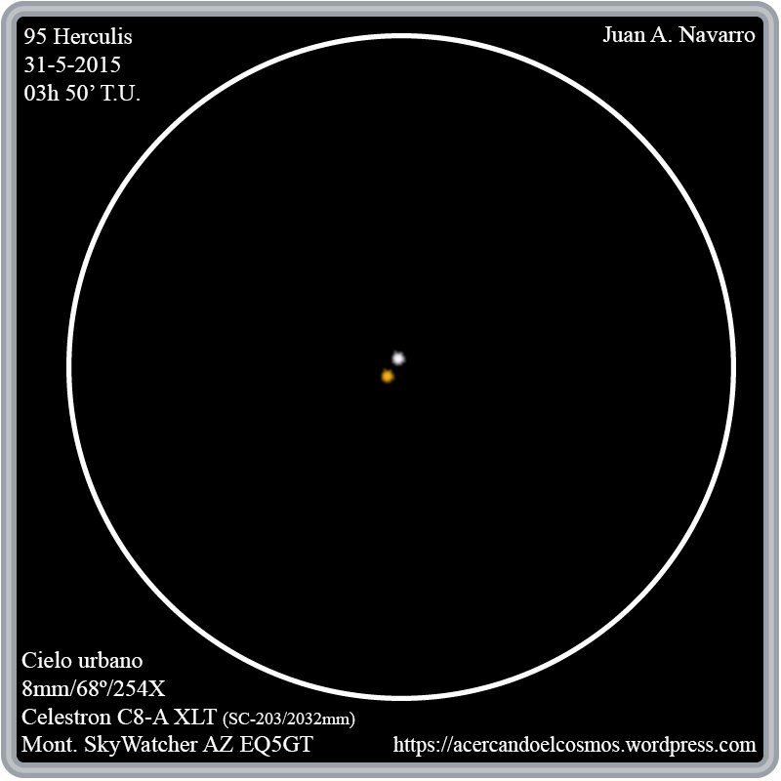
95 Her

Slide 3
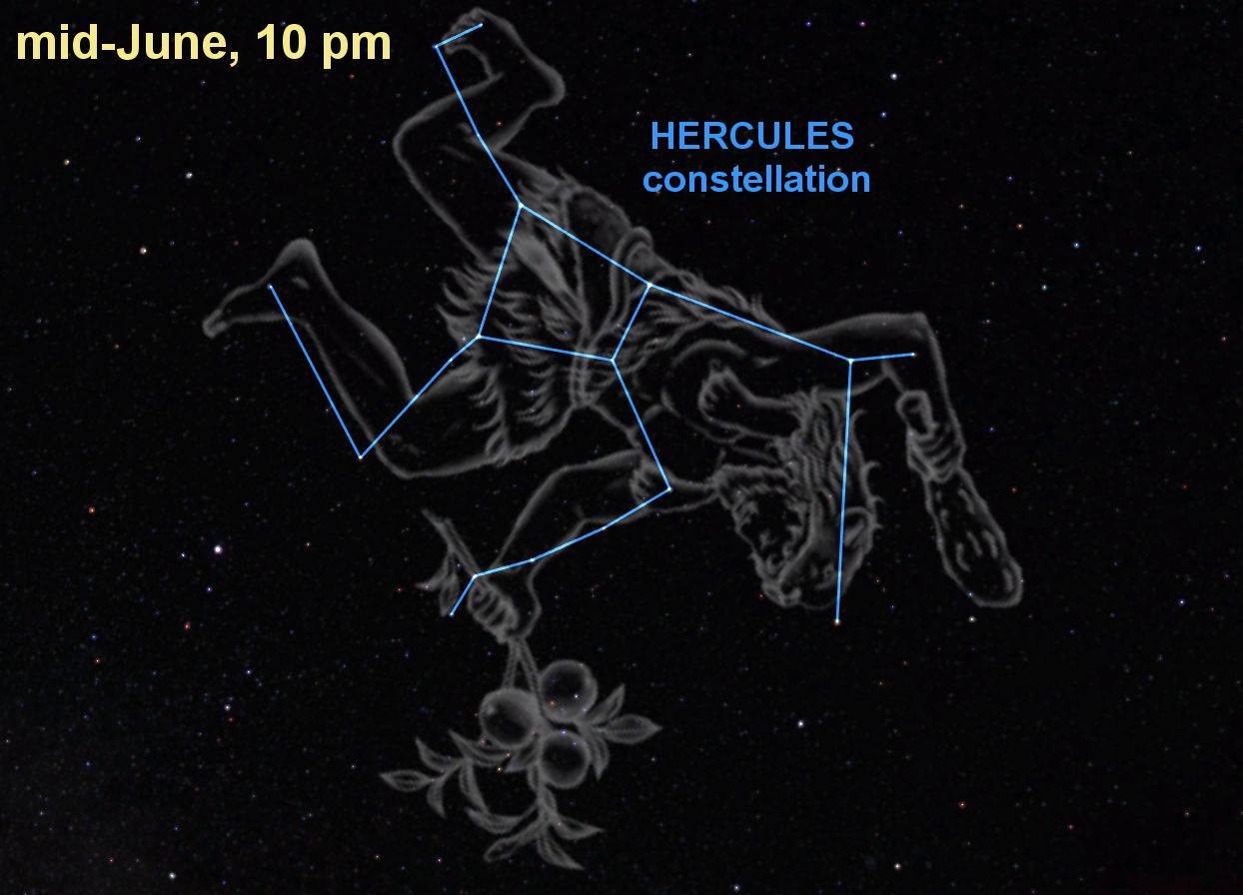
95 Her
95 Her is a
5th magnitude
double star in the constellation Hercules.

Slide 4
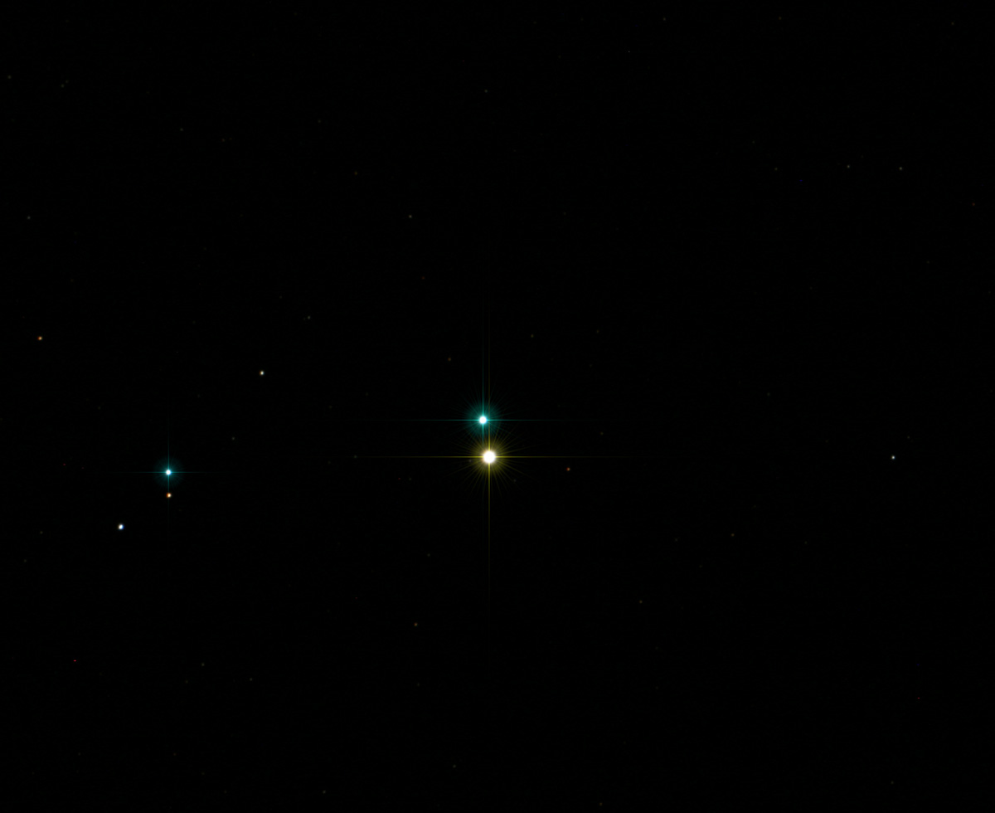
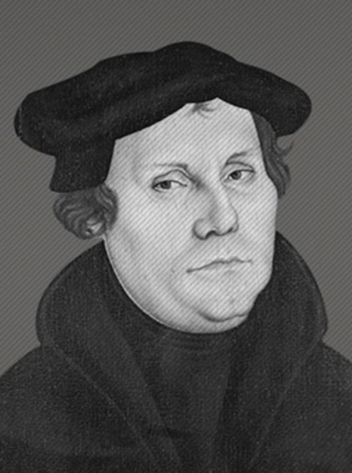
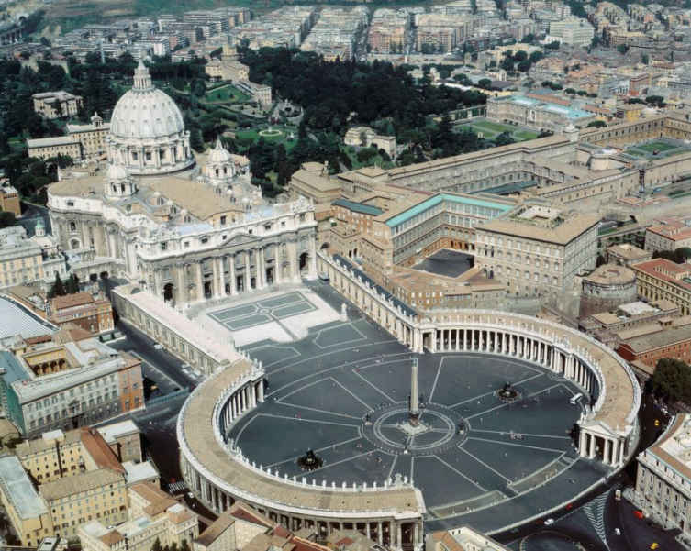
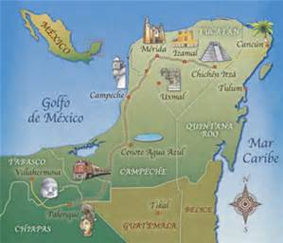
95 Her
470 light years away
Light we’re seeing left in 1546 AD:
• Reformation was happening, but Martin Luther died this year
• Michelangelo was made chief architect of St. Peter’s Basilica in Rome
• Spanish conquest of
the Yucatan was completed

Slide 5
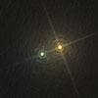
95 Her
They are separated by 882 AU*
*AU stands for Astronomical Unit. One AU is the distance from the Earth to the Sun.

Slide 6
95 Her
The golden star
Type: Yellow-orange, G8III, giant
Luminosity: 176 Suns
Diameter: 19.2 Suns
Temperature: 8180⁰ F
Magnitude: 0.86

Slide 7
95 Her
The silver star
Luminosity: 191 Suns
Diameter: 4.5 Suns
Temperature: 17,700⁰ F
Type: white, A5IIIn, giant
Magnitude: 0.95

Slide 8
95 Her
Silver star
Golden star
White Giant
191 Suns
4,51 Suns
17,700⁰ F
-0.95
Type
Luminosity
Diameter
Temperature
Magnitude
Yellow-Orange Giant
176 Suns
19.2 Suns
8180⁰ F
-0.86
Ye

